Slide 1
Build Mobile Apps with Xamarin
Robert Green
rgreen2005@msn.com

Slide 2


Slide 3


Slide 4

Who Am I?
Worked at Microsoft from 1996-2005
Developer Tools Marketing, Visual Basic team
Independent from 2005-2010
Training for AppDev
Worked at Microsoft from 2010-2019
Developer Evangelism
Creator and host of Visual Studio Toolbox
Spoken at numerous dev conferences

Slide 5
Agenda
Overview of Xamarin
Review various technologies
XAML, MVVM, SQLite, REST APIs
Build an app that runs on Windows, Android, iOS
Full CRUD
Test and deploy locally
Out of scope
Beautiful apps, DevOps, app stores

Slide 6
Demo Script and Source Code
Four versions of the app are in GitHub
https://github.com/rogreen/Xamarin-Workshop-App-V1
https://github.com/rogreen/Xamarin-Workshop-App-V2
https://github.com/rogreen/Xamarin-Workshop-App-V3
https://github.com/rogreen/Xamarin-Workshop-App-V4
Demo script is in the V1 repo

Slide 7
What is Xamarin?

Slide 8
What is Xamarin?
Open-source platform for building modern apps for iOS, Android and Windows with .NET
Abstraction layer that manages link between shared code written in C# and underlying platform code
Apps compile to native application packages
.apk on Android, .ipa on iOS, .exe and Windows

Slide 9
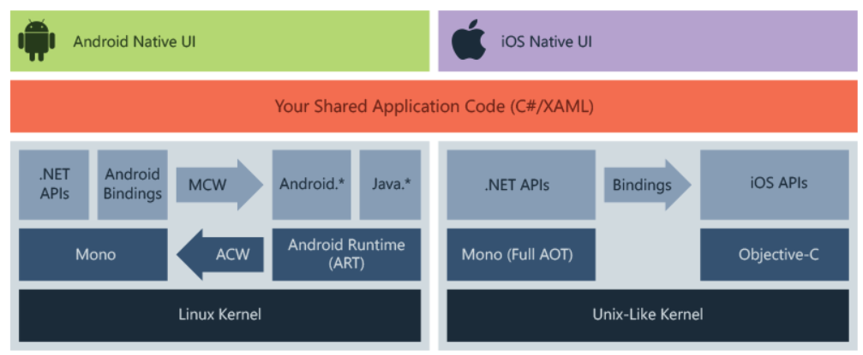
How Does Xamarin Work?
Complete binding for the underlying SDKs
Get access to nearly the entire iOS and Android platform
Write apps in C#
Use .NET BCL and many/most newer features
Interop with Objective-C, Java, C, C++

Slide 10
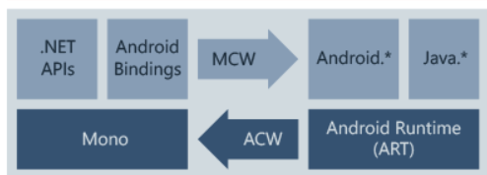
How Does Xamarin.Android Work?
Apps compile from C# to Intermediate Language (MSIL)
Just-in-Time (JIT) compiled into native assembly when app launches
Apps run within Mono execution environment, side by side with Android Runtime (ART)

Slide 11
How Does Xamarin.Android Work?
.NET bindings to Android.* and Java.* namespaces
Mono calls into these namespaces via Managed Callable Wrappers (MCW)
Provides Android Callable Wrappers (ACW) to the ART
Both environments can invoke code in each other

Slide 12
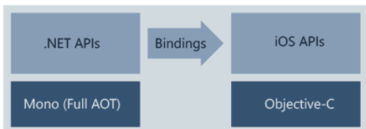
How Does Xamarin.iOS Work?
Selectors expose Objective-C to managed C#
Registrars expose managed C# code to Objective-C
Selectors and Registrars collectively are called "bindings" and allow Objective-C and C# to communicate

Slide 13
How Does Xamarin.iOS Work?
.NET bindings to Android.* and Java.* namespaces
Mono calls into these namespaces via Managed Callable Wrappers (MCW)
Provides Android Callable Wrappers (ACW) to the ART
Both environments can invoke code in each other

Slide 14
What is Xamarin Essentials?
NuGet package that provides cross-platform APIs for native language features
Examples
Device info
File system
Accelerometer
Phone dialer
Text-to-speech
Screen lock

Slide 15
What is Xamarin.Forms?
Open-source UI framework
Write code once AND write UI once
UI is based on XAML
Data binding
Gestures
Effects
Styling

Slide 16
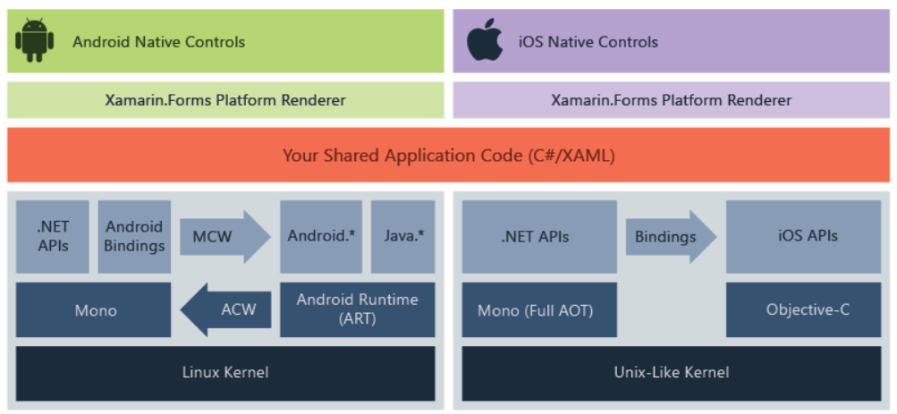
How Does Xamarin.Forms Work?
At runtime, utilizes platform renderers to convert the cross-platform UI elements into native controls

Slide 17
What is XAML?

Slide 18
What is XAML?
eXtensible Application Markup Language
XML based instructions to UI renderer on how to draw pages
Same purpose as HTML
First showed up as Windows Presentation Foundation (WPF) in 2006
Also used in Silverlight, Windows Phone, Windows 8 (Metro), UWP, Xamarin.Forms
XAML uses a containership model

Slide 19
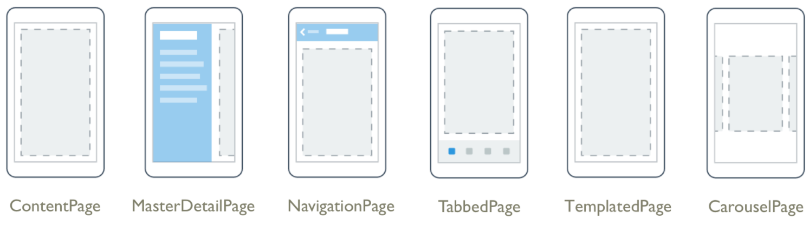
Xamarin.Forms Pages
Highest level is page, which occupies entire screen

Slide 20
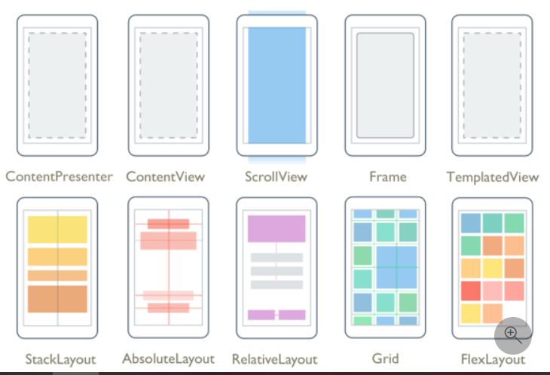
Xamarin.Forms Layouts
Pages contains a Layout, which contains UI elements

Slide 21
Xamarin.Forms Views
Views are UI controls
Presentation
Labels, Images
Initiate commands
Buttons, ImageButtons, RadioButton
Set values
CheckBox, DatePicker, TimePicker
Edit text
Entry, Editor
Indicate activity
ProgressBar
Display collections
CollectionView, ListView

Slide 22
Demo
Gentle introduction to XAML and Xamarin

Slide 23
Build The HoneyDo App

Slide 24
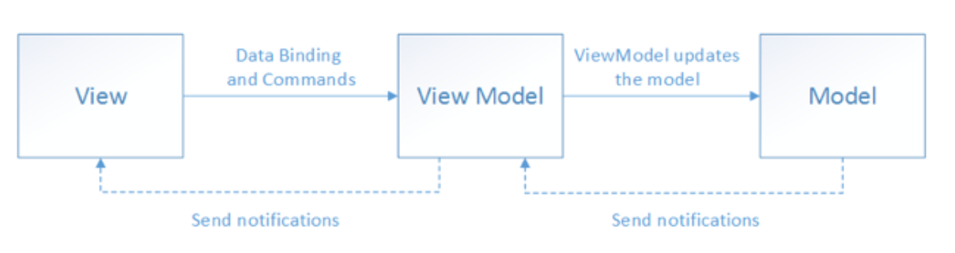
What is MVVM?
Model-View-ViewModel pattern
Similar purpose to MVC (Model-View-Controller)
Separates business and presentation logic from the UI
App is easier to test, maintain, evolve

Slide 25
What is SQLite?
Open-source, small, fast, self-contained, serverless, full-featured SQL database engine
Database is stored in a single file
Runs on Windows, Android and iOS

Slide 26
References
Xamarin documentation
https://docs.microsoft.com/en-us/xamarin/
Build Cross Platform Apps with .NET MAUI
Maddy Leger talk on Wednesday at 9
Evolving Your Xamarin.Forms Apps to .NET MAUI
Maddy Leger talk on Wednesday at 2:15

Slide 27
Don’t forget to complete an online eval
Build Mobile Apps with Xamarin
Your evaluation helps organizers build better conferences and helps speakers improve their sessions.
Thank you!

Slide 28


